Slide 1
NewsFeed
Week 1 Progress
Chris Jacob Bobby

Slide 2
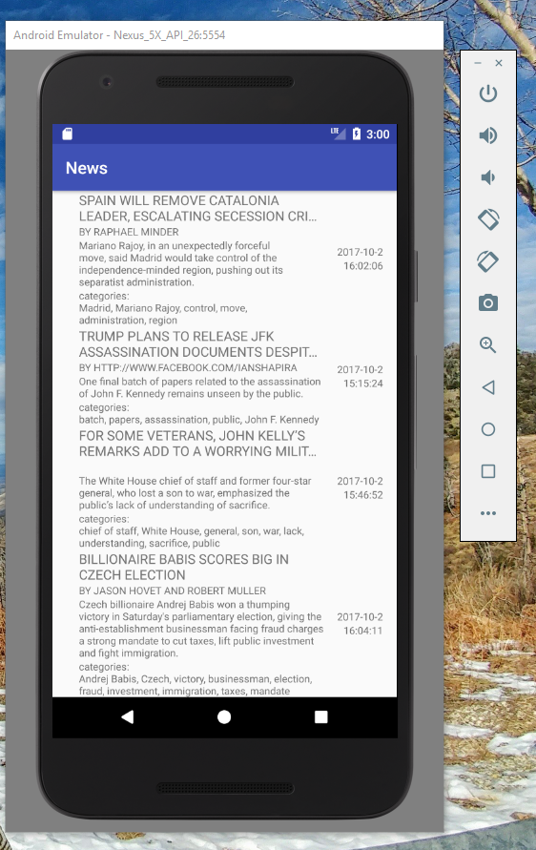
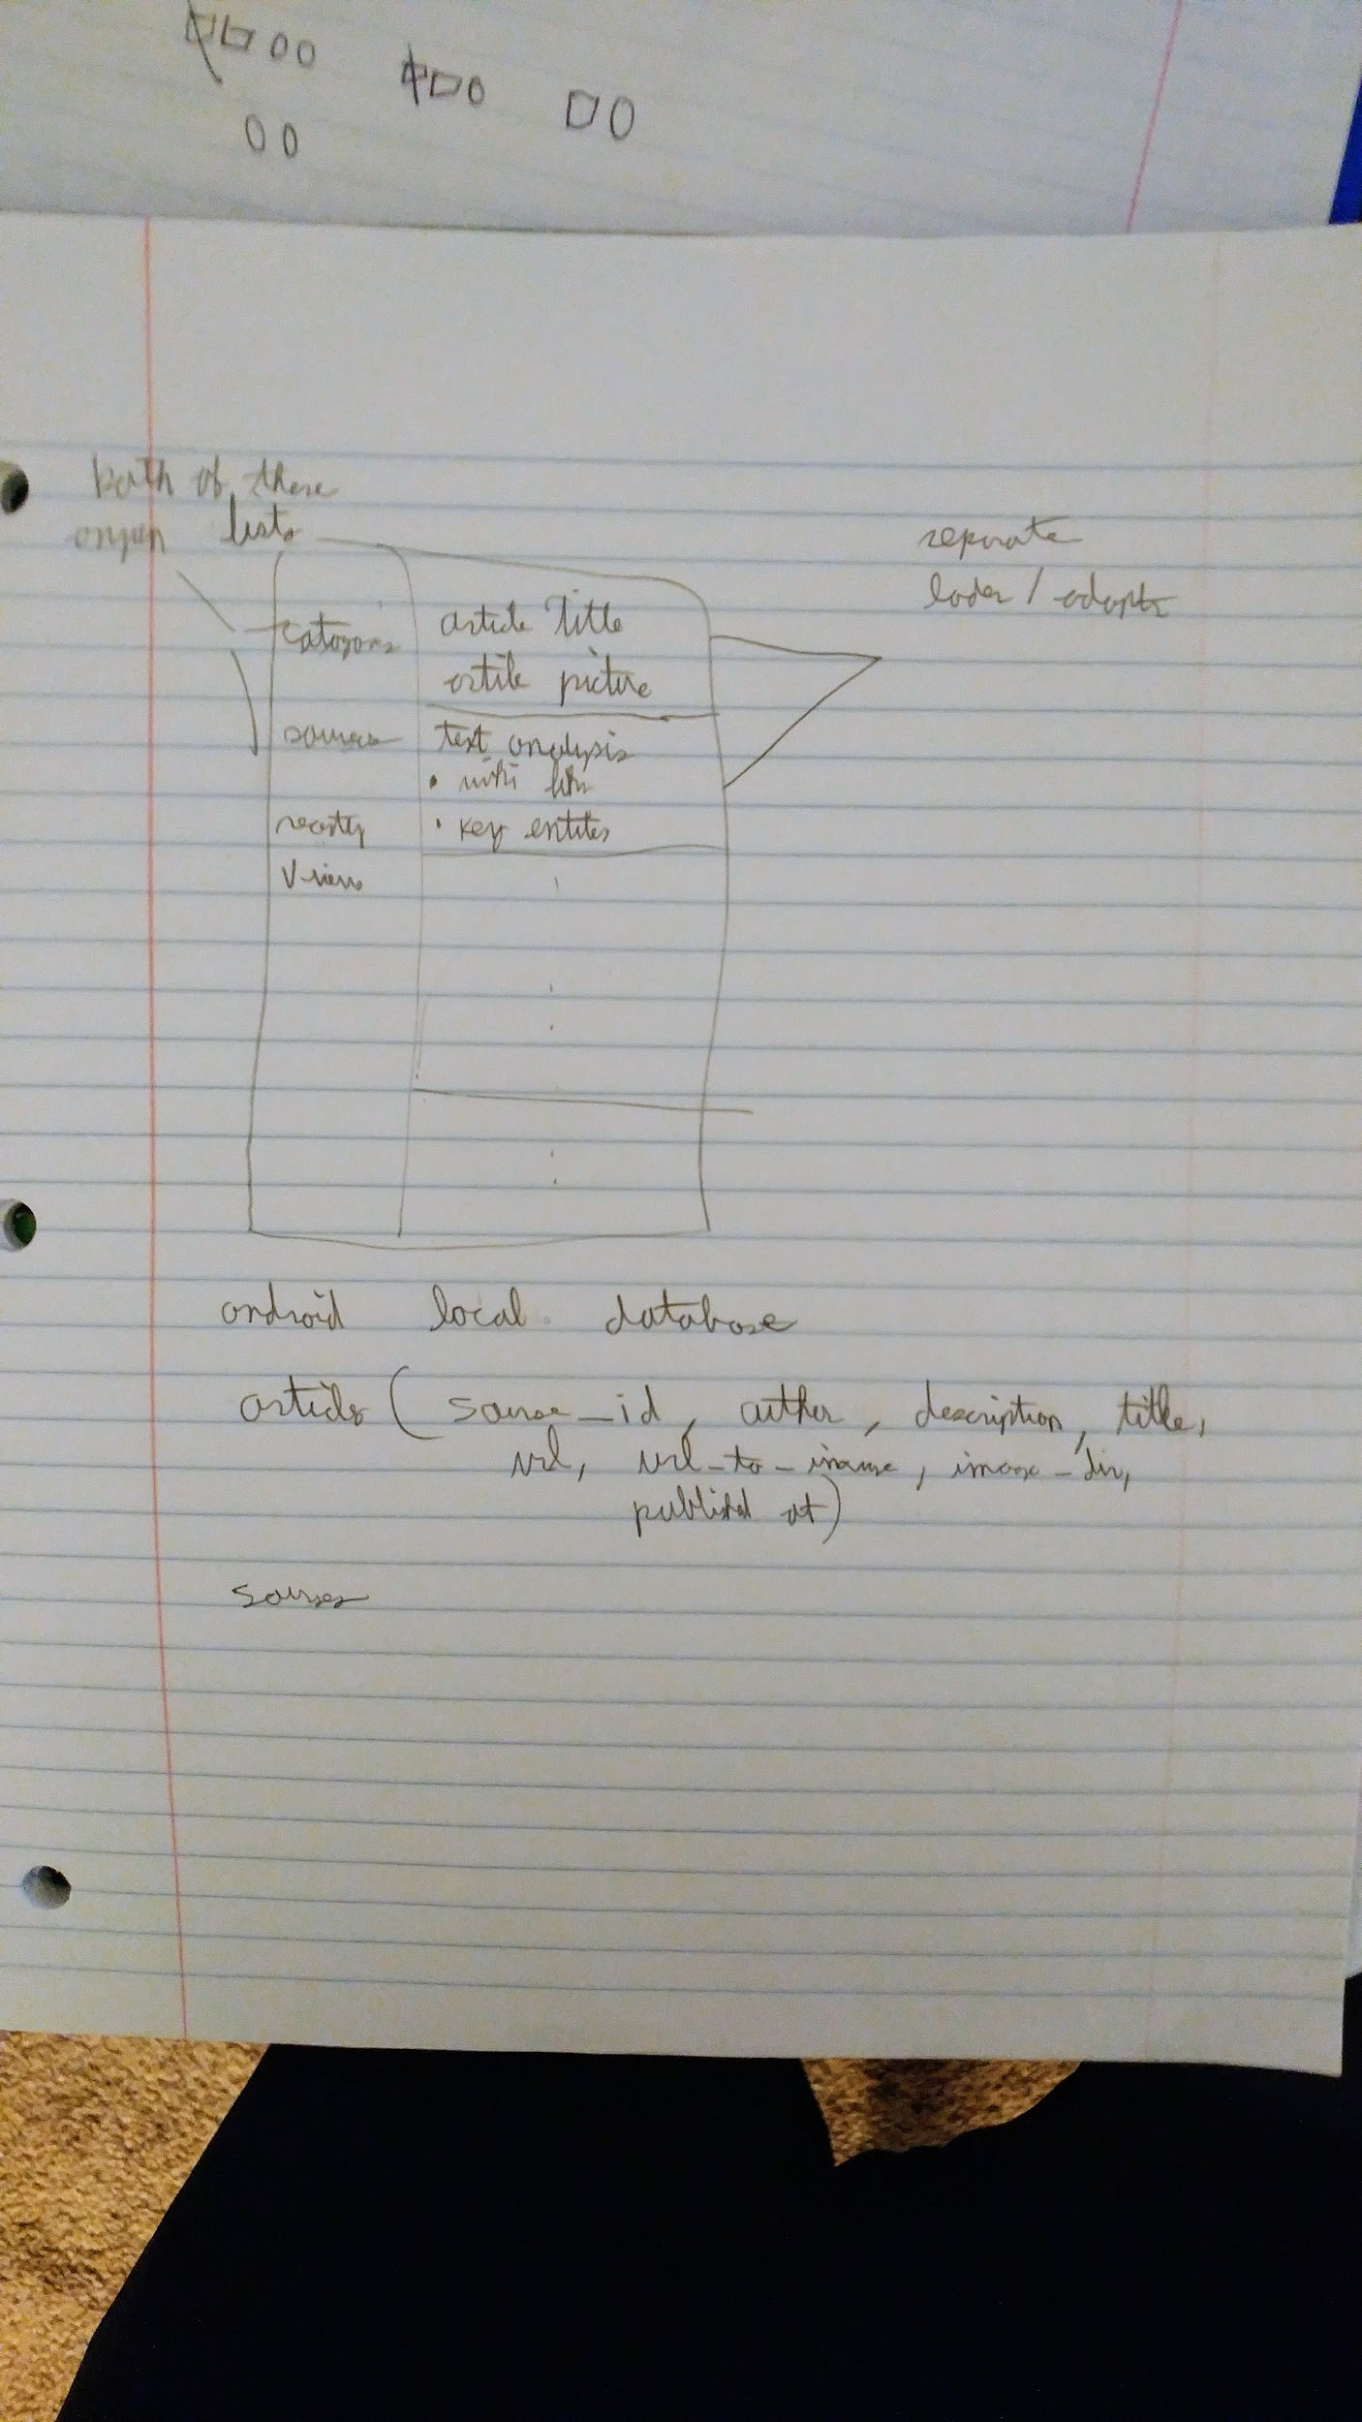
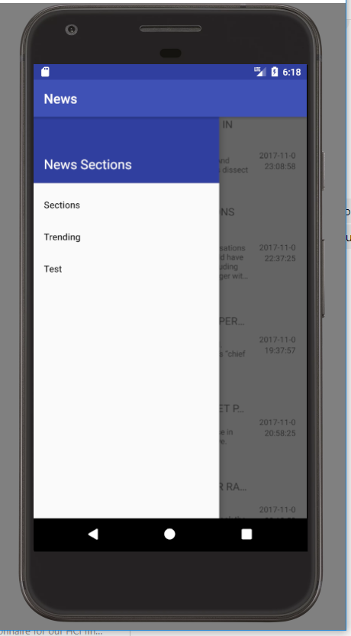
Screenshots

